Slide 1

Decoding the Housing Market
A Descriptive Study of 545 Residential Properties
Presenter: Earl Tavera

Slide 2

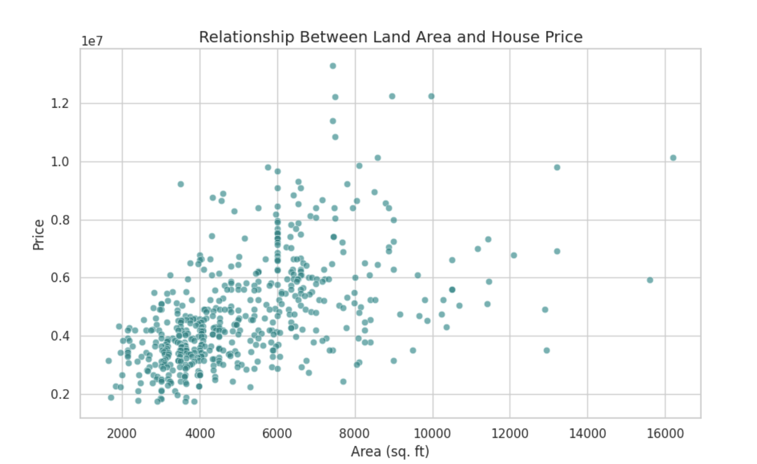
The Physical Baseline (Size Matters)
Core Correlation: There is a moderate positive correlation (r = 0.54) between area and price.
Average Specs: Most properties feature ~5,150 sq. ft. with 3 bedrooms.
Land Area vs. Price
Size sets the "floor" for the price, but doesn't explain the "ceiling."

Slide 3
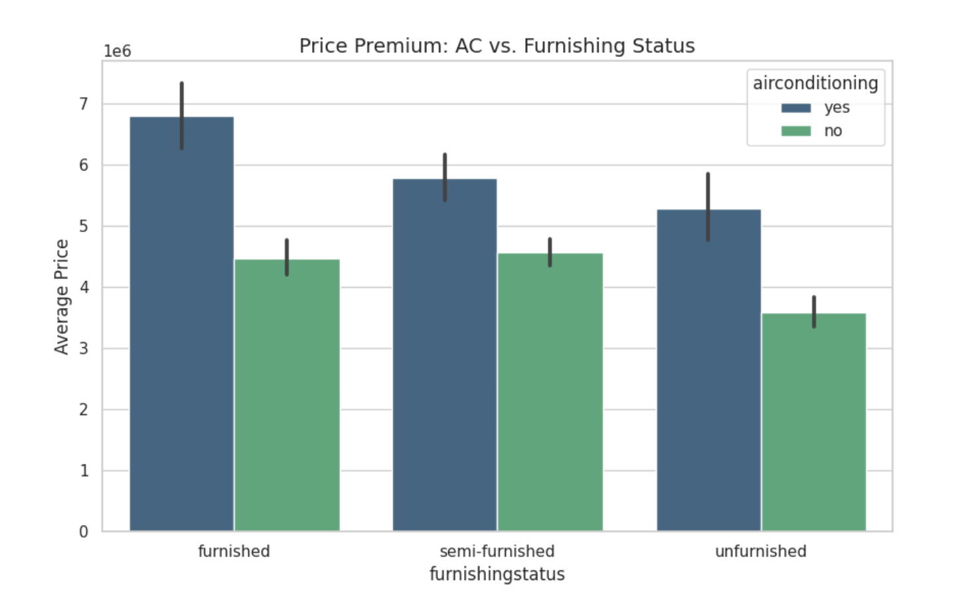
The ”Luxury factor" (Amenities)
AC Impact: Homes with AC average $6.01M vs. $4.19M without it.
Furnishing Status: Fully furnished homes command a 37% premium over unfurnished ones.
The Power of Air Conditioning & Furnishing
Descriptive aggregation shows that adding AC increases the average price by nearly 43% ($1.8M), which is a massive ROI compared to simply adding more square footage."

Slide 4
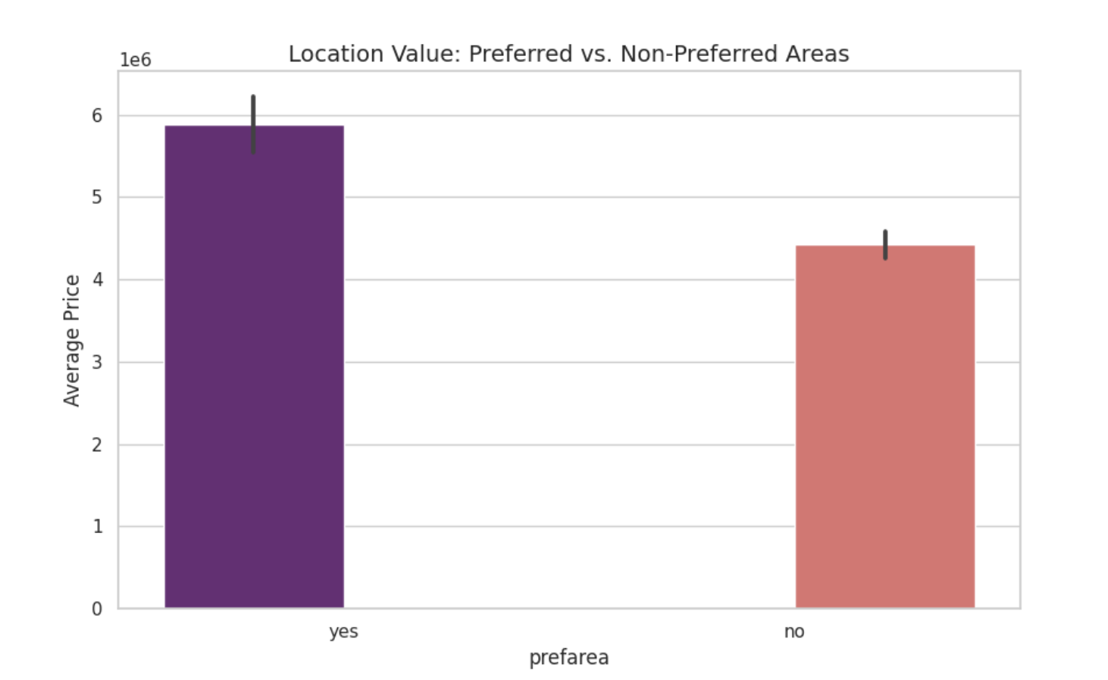
Location & Infrastructure
Location Premium: Homes in a "Preferred Area" cost $1.4M more on average.
Accessibility: Proximity to main roads and parking capacity significantly increases a property's marketability.
The Value of "Preferred Areas"
You can't change a house's location; the market places a heavy premium on prestige and connectivity.

Slide 5
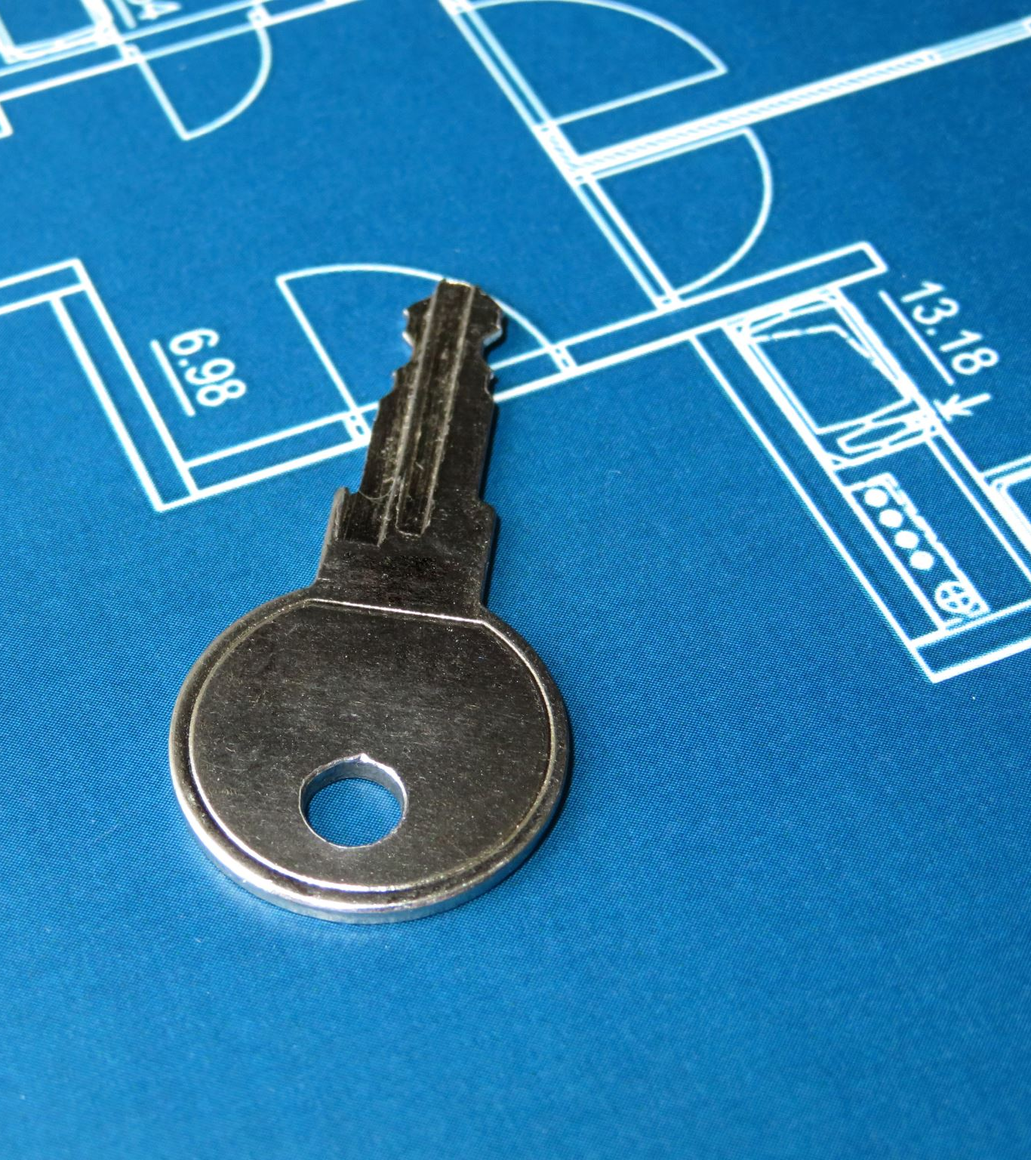
Conclusion & Strategy
Summary: The Ideal Investment
Key Takeaways:
For Sellers: Installing AC and semi-furnishing a home yields a higher ROI than major structural changes.
For Buyers: The best "value" is found in unfurnished homes in preferred areas—size is fixed, but amenities can be added.
Final Thought: Data shows that comfort and location outweigh raw square footage in the
high-end market.

